Slide 1
Explora Tutorial
for Middle and High School Users
connect.ebsco.com

Slide 2
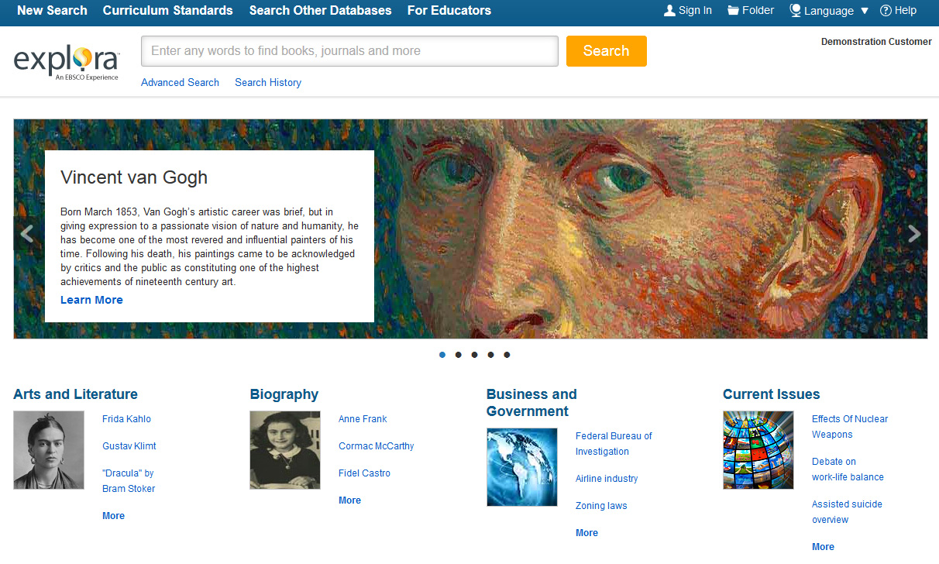
Welcome to Explora, EBSCO’s engaging interface for schools and public libraries. Designed to meet the unique needs of its users, Explora supports student research, classroom instruction, and patron information needs with rich, reliable content and easy-to-use functionality. In this tutorial, we will conduct a basic search, review the available browsing options, and explore the database’s unique features.

Slide 3
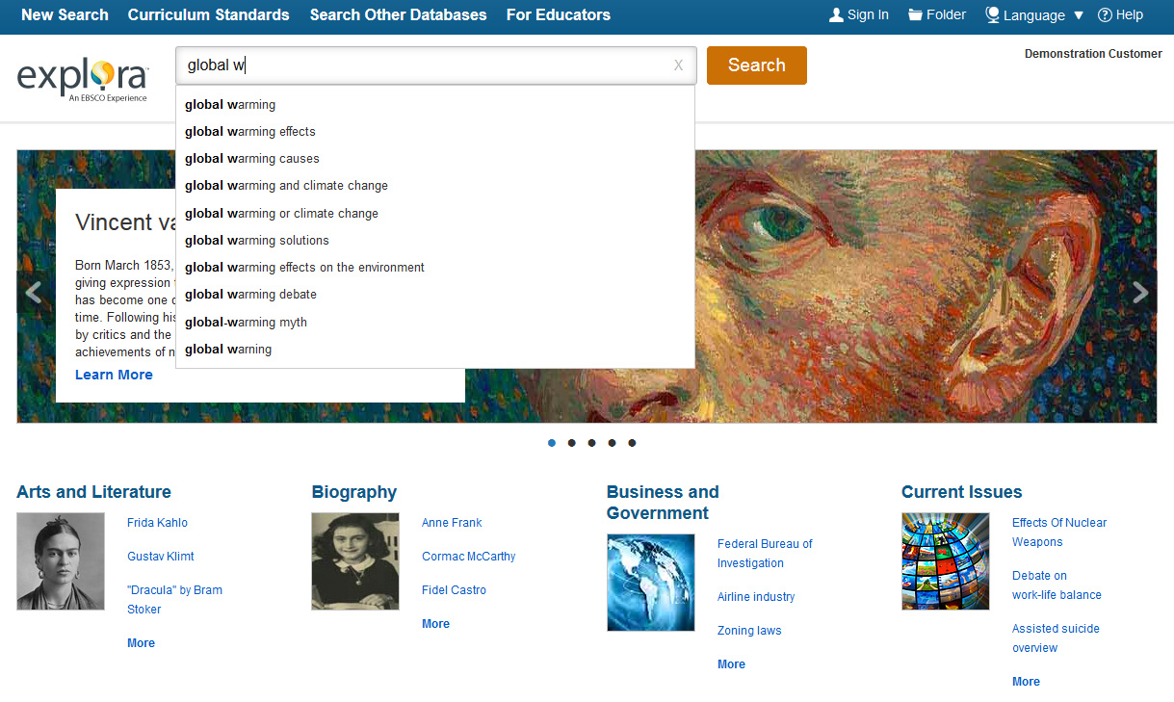
Let’s begin by conducting a search from the home page. Enter your keywords in the search box. The Autocomplete feature will anticipate your search terms, so even if you misspell a word, relevant search terms will appear in the drop-down menu. You can select from the list or finish entering your keywords and click Search to generate a list of results.

Slide 4
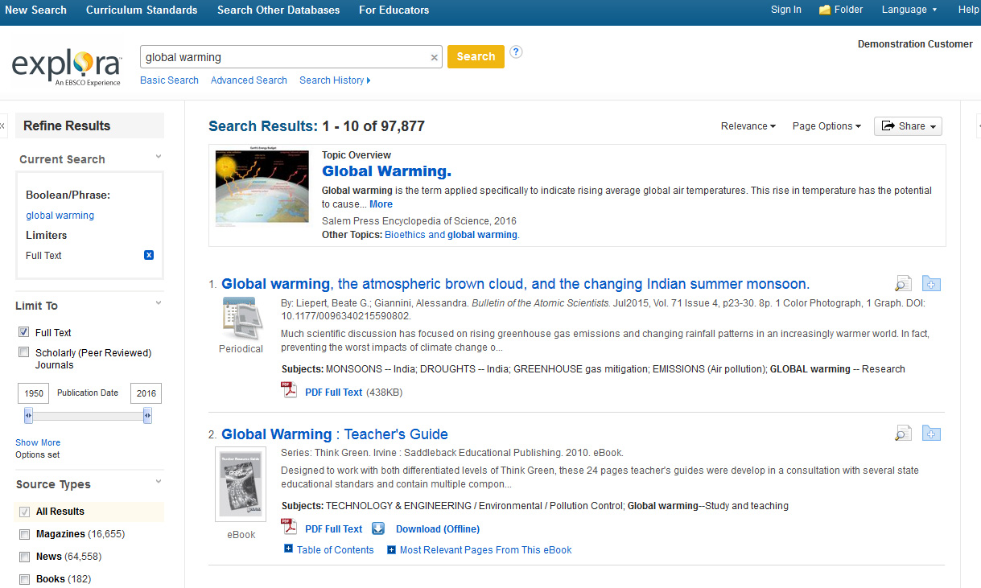
Many results include a Topic Overview on the result list. This convenient feature provides you with the background information needed to start your research. Clicking More takes you to the full article.

Slide 5
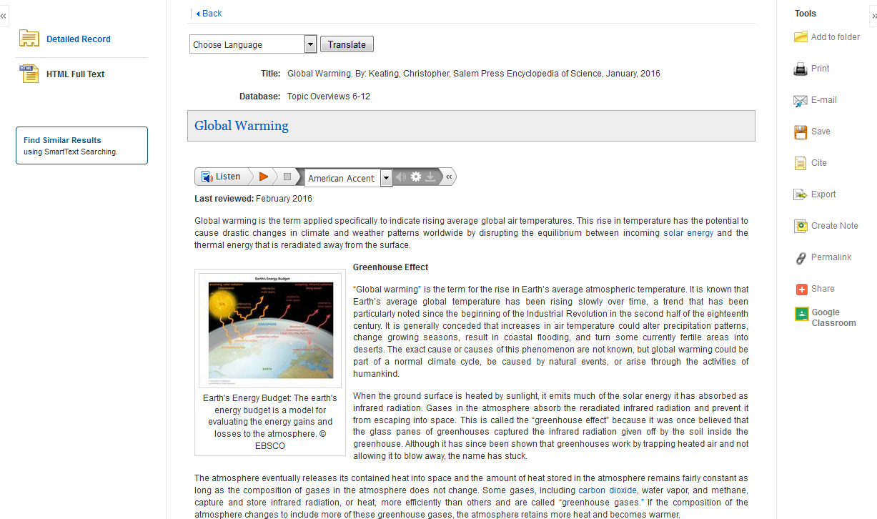
From here, you can read the full text of the article or listen to the article using the Text-to-Speech feature. Depending on your search term, the overview article may contain additional links within the full text that will take you to related Topic Overview records.

Slide 6
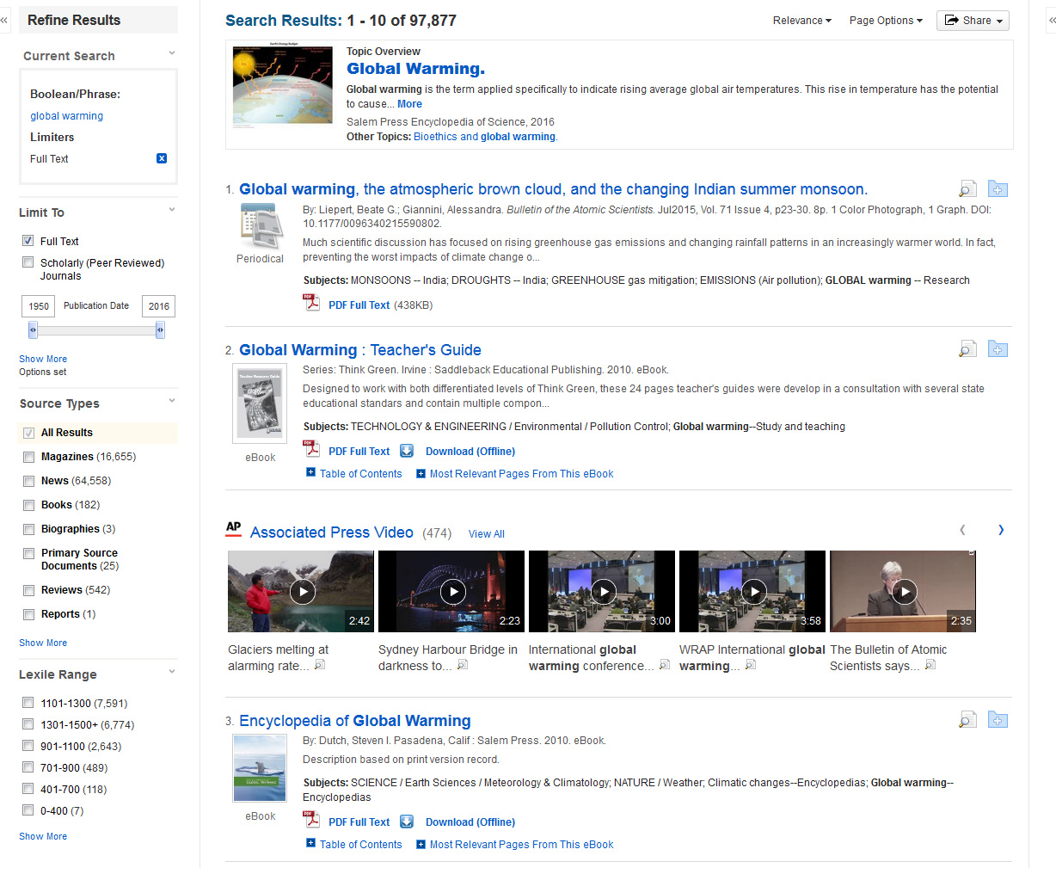
By default, your search results will appear in order of relevance, but you can also sort articles by publication date.
Filters help you further refine your search results. For example, select Full Text to limit your results to only records with complete articles. You can also limit results by Source Type, such as Books, Magazines, News, or Primary Source Documents. Use the Lexile Range limiter to find articles suited to your reading level.

Slide 7
Click on a Full Text link to view the full text article, or click the title to view details about the article. Don’t have time to read it now? Sign in and click the folder icon to save the record to your personal folder.

Slide 8
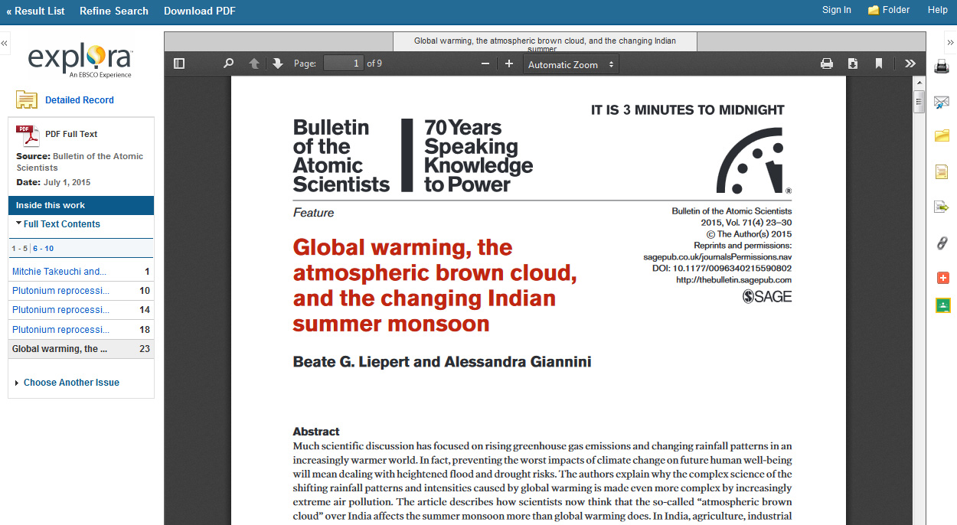
From the PDF Full Text screen, you can also print or save the complete article to your computer by using the icons found in the Adobe Reader toolbar. Use the Tools Menu to print, email, cite, export, or add the result to your personal folder.

Slide 9
Educators using Google Classroom can share Explora content with their students. Once you’ve logged in to Google Classroom, simply select a Class and an Action to share your article.

Slide 10
From the Explora home screen, you can also view an image carousel of timely topics, updated weekly. Click the Learn More link for a list of results related to that topic. Click the left and right arrows to navigate the carousel.

Slide 11
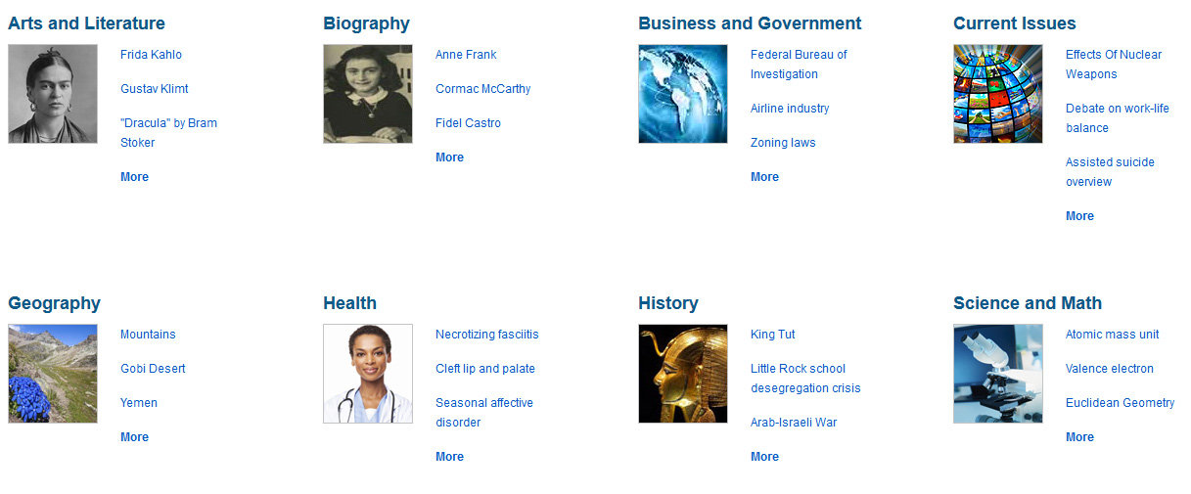
Below the image carousel are categories to browse for research ideas. Click a link to one of the featured topics OR click on the More link to view an alphabetical list of all topics in that category.

Slide 12
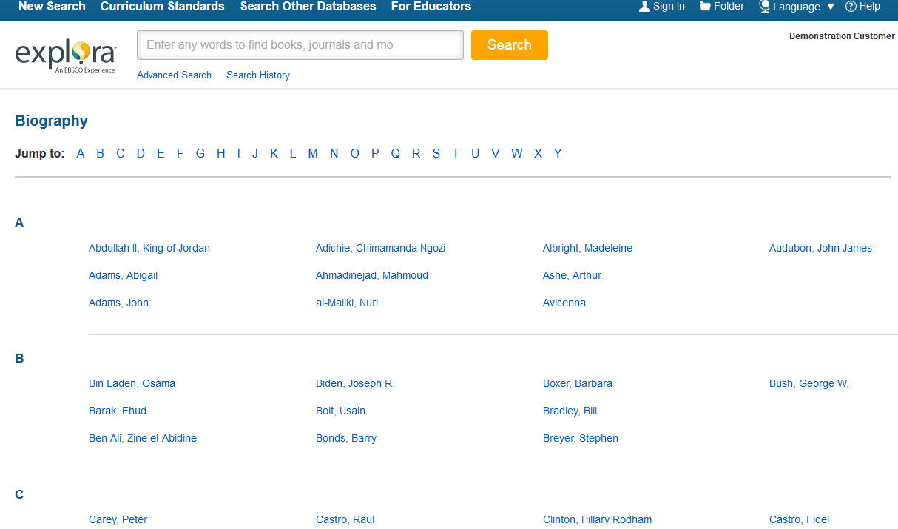
From the Category Browse page, you can click a letter to jump ahead in the alphabetical list of topics. Click the topic link for a list of relevant results. Each topic includes a Topic Overview on the search results page.

Slide 13
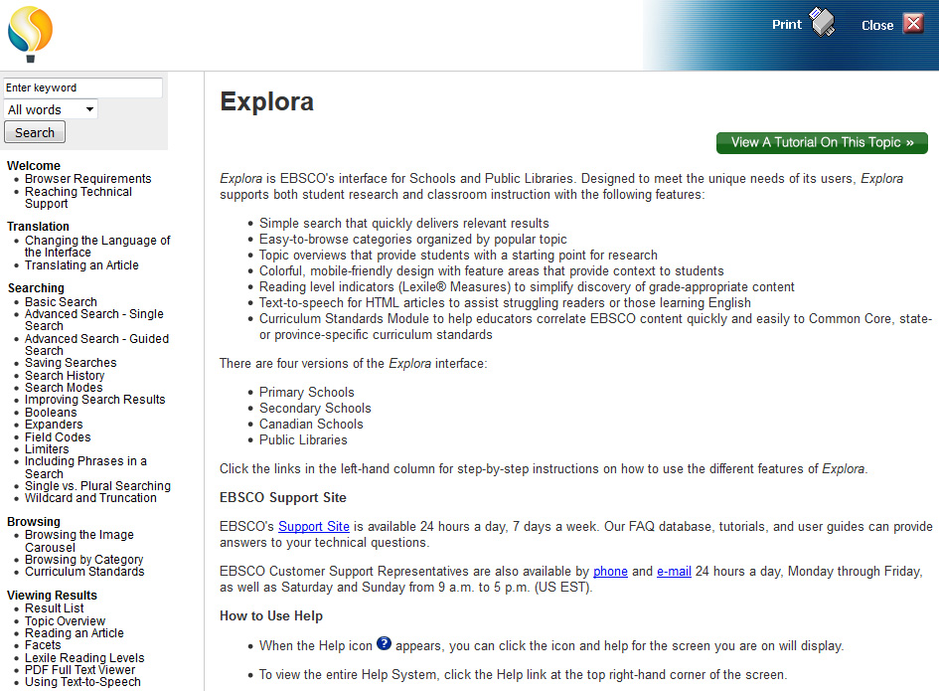
If at any time you wish to return to the home screen, click the Explora logo. To view the complete online Help system, click the Help link at the top right of your screen.

